Slide 1






IIT MADRAS ENCRYPTCON
TEAM
PS3 - BEHAVIORAL ANALYTICS FOR SECURITY IN FINANCIAL TRANSACTIONS
Vishwa Kumaresh
Adithya Vedhamani
Lohith K Saradhi
L Achintya

Slide 2
$4.7 TRILLION!
5% of global corporate revenue, translating to a mind-boggling $4.7 trillion(According to a report by ACFE), is pocketed by fraudsters. Astonishingly, 93% of banking-related fraud happens online (According to the Financial Crime Report Q2 2021). This shows the pressing need for an improved Anomaly Detection System.

Slide 3
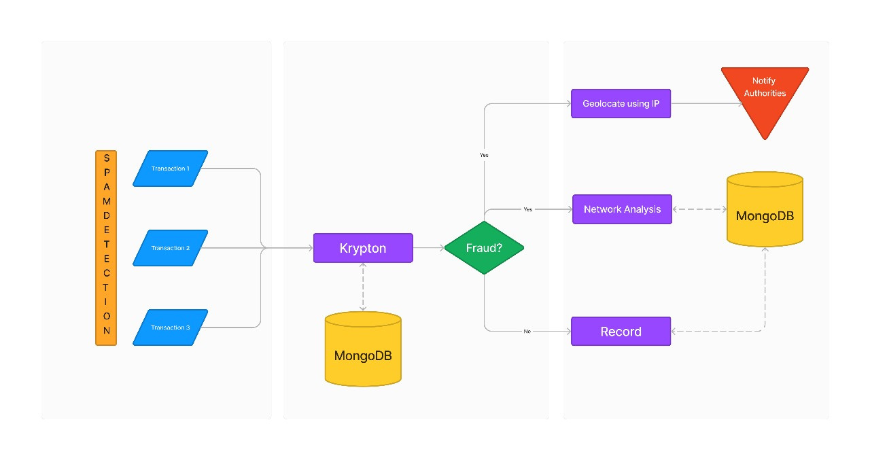
FLOWCHART
PREVENTION
DETECTION
MITIGATION

Slide 4
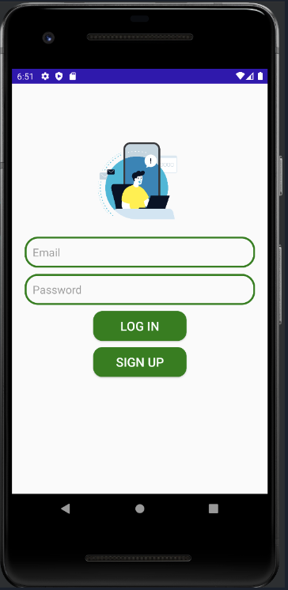
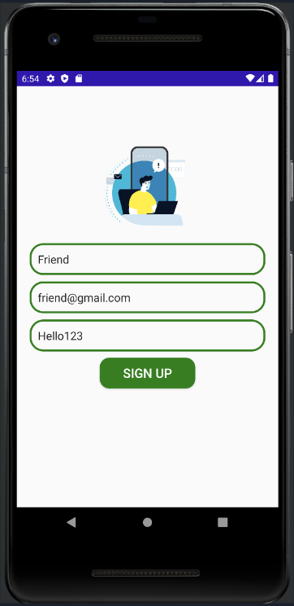
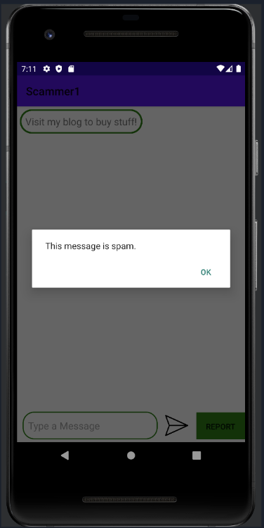
SCREENSHOTS

Slide 5
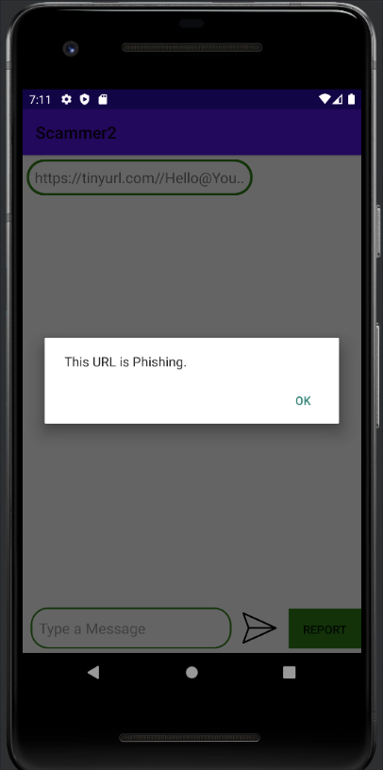
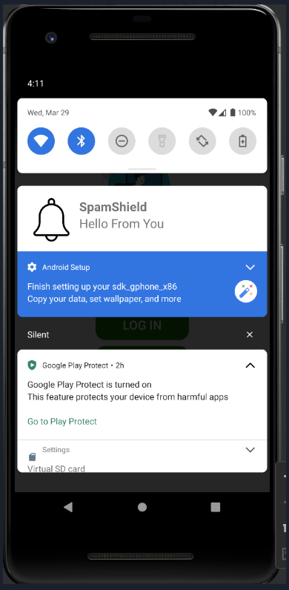

Slide 6
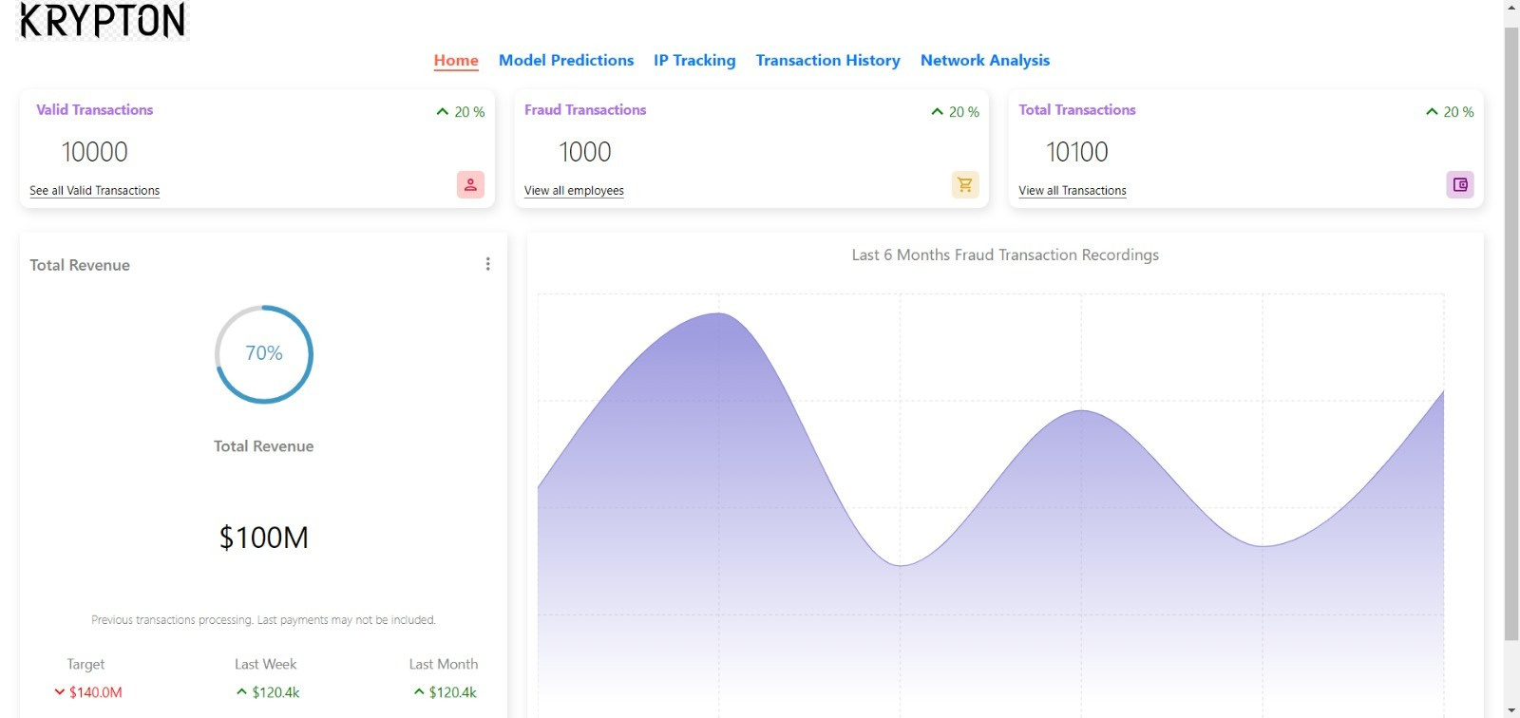

Slide 7
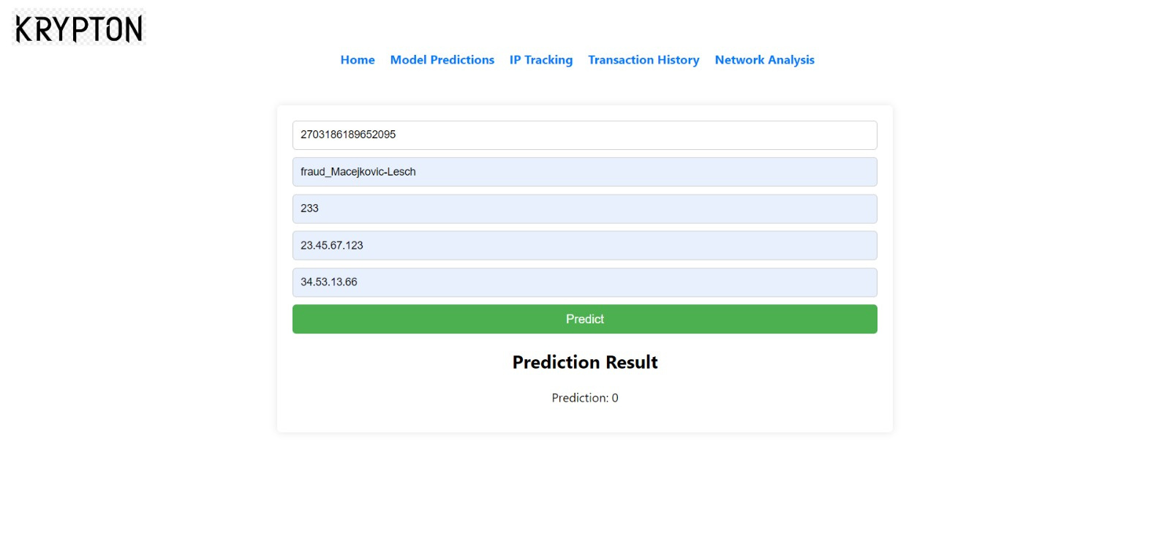

Slide 8
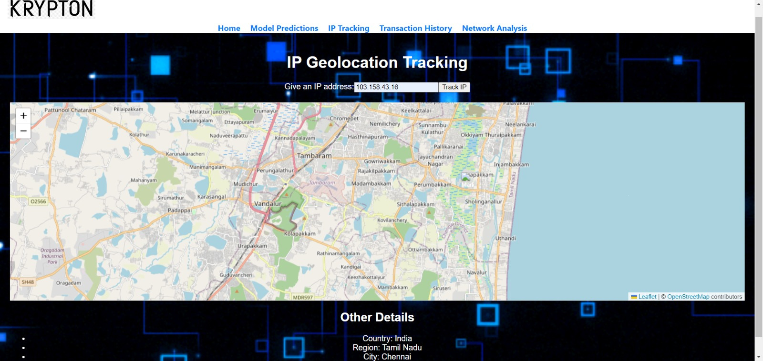

Slide 9
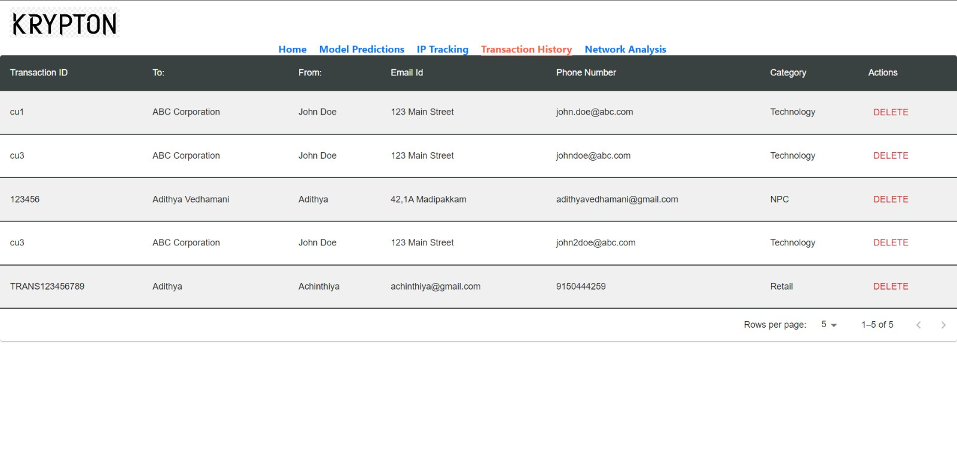

Slide 10
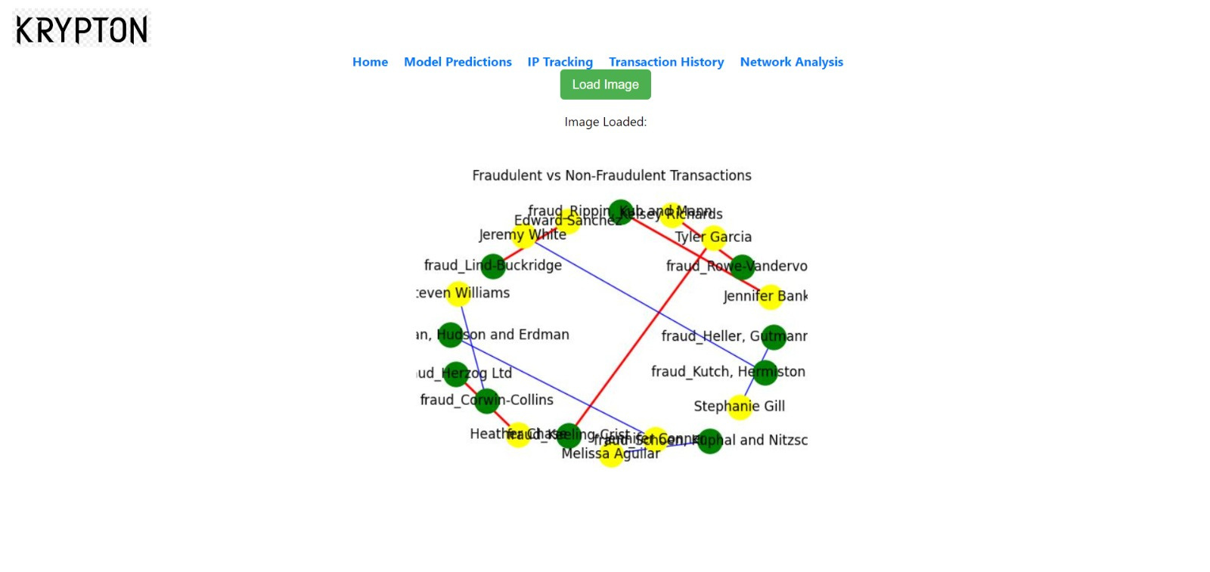

Slide 11









TECHSTACK

Slide 12
THANK YOU!

Slide 13


DEMO VIDEO
GITHUB LINK

